Slide 1
Secure & govern agents in Microsoft 365 from grounding data to interactions A Microsoft Purview deployment blueprint

Slide 2


Microsoft Purview
A unified approach to secure and govern your data in the era of AI
Data security
Data governance
Data compliance
Dynamically secure data throughout its lifecycle
Responsibly unlock value creation from data
Manage critical risks and regulatory requirements
Data Loss Prevention
Insider Risk Management
Information Protection
Data Security Posture Management
Data Security Investigations
Data Discovery
Data Quality
Data Curation
Data Estate Health
Compliance Manager
eDiscovery and Audit
Communication Compliance
Data Lifecycle & Records Management
Unstructured & Structured data
Traditional and AI generated data
Microsoft 365 and Multi-cloud
Shared Capabilities Value
Data Map l Connectors l Classification l Labels l Audit l Visibility
Notes:
The Microsoft Purview family is here to help you secure and govern data across third party IaaS and SaaS, multi-platform data environment, while helping you meet compliance requirements you may be subject to. Purview brings simplicity with a comprehensive set of solutions built on a platform of shared capabilities, that helps keep your most important asset, data, safe.

Slide 3
Microsoft Purview
Comprehensive solution to discover, protect, and govern data
Wherever your data flows
Agents in Microsoft 365
Grounding data
Interaction data
Knowledge sources
Interactions
Microsoft 365
Beyond Microsoft 365
Prompts
Responses
Notes:
When it comes to Agents in Microsoft 365, Purview not only secures the grounding data in Microsoft 365 and Beyond, such as SharePoint and Dataverse, it also secures the interactions, or prompts and responses, users have with the agents.

Slide 4
Problem summary
Agents in Microsoft 365 Copilot’s leveraging information in SharePoint and Dataverse has raised concerns for organizations about oversharing, data loss, and insider risks.
If grounding data and agent interactions are not secured, it could lead to
Access to information beyond what the user needs for their role
Unauthorized disclosure of confidential information
Out of date or irrelevant responses
By addressing these risks, organizations can ensure that agents are secured end to end

Slide 5
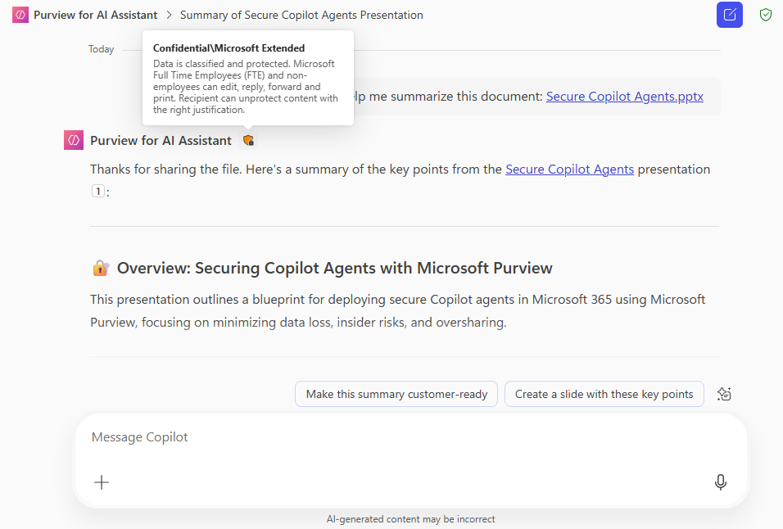
Copilot agent conversation displays the sensitivity label of referenced file and data
A sensitivity label is displayed for the entire conversation.
Conversations displays the most restrictive sensitivity labels from the references used to formulate a response.
Notes:
Power platform connectors are MIP aware! labels from original grounding data like outlook, excel, word, sql, etc are passed through MCS experiences and interactions, and logged.

Slide 6
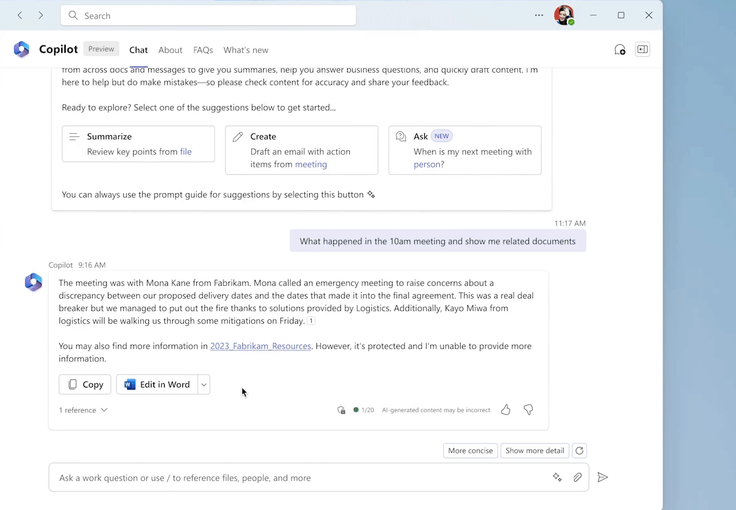

Honoring access control restrictions on labeled content
Only content from references where the user has appropriate permission will be included in responses.
If a user lacks the right permissions, Copilot agent will inform the user and provide a link but will not include the content for generating responses.
Copilot will not include information from referenced files where the user does not have appropriate access rights.
Notes:
Talking points:
This demo auto plays to highlight the summary from reference information the user has extract permissions
Then information about relevant references where the user does not have extract permissions

Slide 7
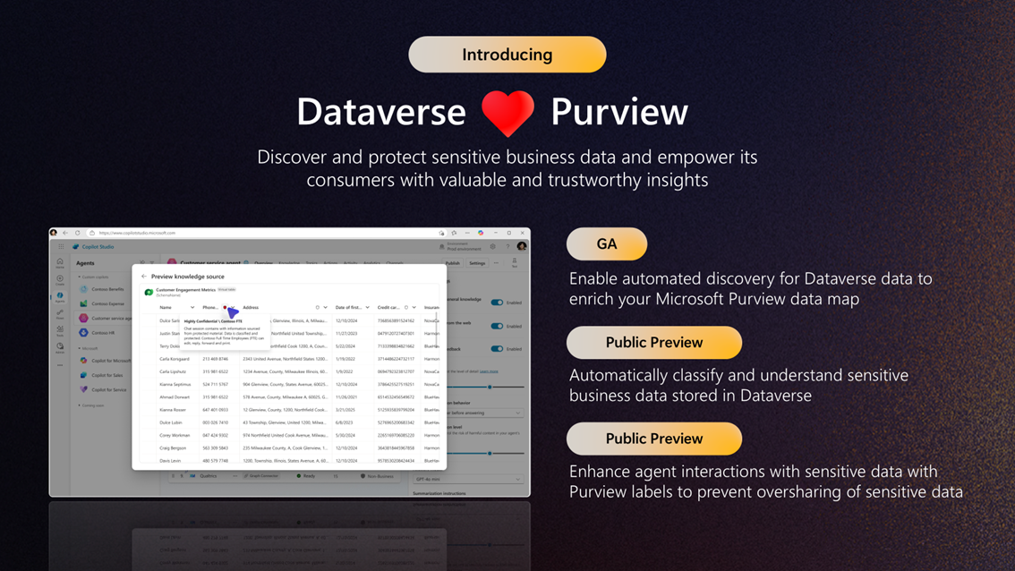

Slide 8
Secure & govern agents in Microsoft 365
Protect grounding data
Protect interactions
Discover
Govern
Discover risks and identify gaps
Protect sensitive info in grounding data
Protect interactions against data loss and insider risks
Govern interactions
Turn on Purview Audit
Apply sensitivity label to SharePoint and Dataverse
Automatic sensitivity label reference from SharePoint and Dataverse
Retain/delete interactions
Discover oversharing risks with Data risk assessment
Detect inappropriate behaviors
Reduce stale data to improve response accuracy
Restrict Copilot from processing sensitive files referenced in interactions
Investigate prompts and responses
Activities
Discover sensitive info in Dataverse with Unified catalog
Restrict files from Copilot processing
Investigate grounding data and interactions
Discover risky AI activities with DSPM for AI Apps and Agents report
Implement data loss policies for SharePoint and Data policies for Dataverse
Identify & address gaps in meeting AI regulations
Detect Risky AI interactions
Outcomes
Potential gaps in data security is discovered
Sensitive info in grounding data is not used as knowledge source
Interactions are protected from data loss and insider risk
Interactions with agents is retained for future investigations
Last updated: September 16, 2025

Slide 9
Discover
Turn on Microsoft Purview Audit to log all interactions with grounding data and interactions with AI apps and agents
Discover potential oversharing in SharePoint/OneDrive with Microsoft Purview data risk assessments
Discover where sensitive info resides in Dataverse with Microsoft Purview Data Governance’s Unified catalog
Discover risky AI activities with Microsoft Purview Data Security Posture Management (DSPM) for AI’s Apps and Agents report

Slide 10
Protect grounding data
Apply sensitivity label to SharePoint and Dataverse
Reduce stale data to improve agent response accuracy with Microsoft Purview Data Lifecycle Management
Restrict sensitive files labeled with specific sensitivity labels from Copilot processing and acting as knowledge source with Microsoft Purview Data loss prevention (DLP) for Copilot
Implement Data policies for Dataverse to restrict sensitive data from being used as knowledge source for agents
Implement oversharing DLP policy for SharePoint/OneDrive to detect anyone sharing links for labeled and unlabeled data

Slide 11
Protect interactions
Sensitivity labels applied to data in SharePoint and Dataverse is automatically displayed and respected by the conversation
Restrict Copilot from processing sensitive files referenced in interactions with DLP for Copilot, which also ensures the sensitive prompts are not used for web query
Detect Risky AI interactions with Microsoft Purview Insider risk management’s Risky AI policy

Slide 12
Govern interaction data
Retain interactions for future investigations, and delete interactions based on retention requirements to reduce risk and liability with Microsoft Purview data lifecycle management policies
Detect inappropriate behaviors with Microsoft Purview Communication Compliance policies with built-in classifiers such as jailbreak, harassment, inappropriate images, etc.
Investigate legal and internal cases with Microsoft Purview eDiscovery
Investigate interactions and grounding data leveraging the power of AI with Microsoft Purview Data security investigations (DSI)
Identify & address gaps in meeting AI regulations with Microsoft Purview Compliance Manager

Slide 13
Additional resources
Data security and protections for AI with Microsoft Purview: Microsoft Purview data security and compliance protections for Microsoft 365 Copilot and other generative AI apps | Microsoft Learn
Join the Microsoft customer connection program aka.ms/JoinCommunity
Deployment guides: DSPM for AI: aka.ms/DSPMforAI/Deploy Data Risk assessment: aka.ms/DSPMforAI/Oversharing
Accelerate your Information Protection and Data Loss Prevention deployment: https://aka.ms/PurviewDeploymentModels/SecureByDefault
Notes:
And here are some great links to keep learning.

Slide 14
Purview for Dataverse resources
Connect to and manage Microsoft Dataverse in Microsoft Purview | Microsoft Learn ​
View sensitivity labels for SharePoint data sources - Microsoft Copilot Studio | Microsoft Learn
Apply sensitivity labels to your data in Microsoft Purview Data Map (preview) | Microsoft Learn ​​
Security in Microsoft Dataverse - Power Platform | Microsoft Learn
Notes:
And here are some great links to keep learning.

Slide 15
Thank you
Microsoft Deployment models
Read the detailed guide for this model at aka.ms/PurviewDeploymentModels/SecureM365Agents

